Slide 1


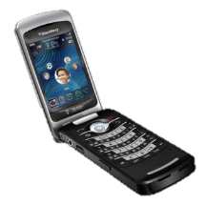
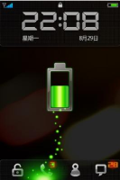
jQuery Mobile
What is jQuery Mobile? How to use it?
Doncho Minkov
Technical Trainer
Telerik Corporation
www.telerik.com

Slide 2
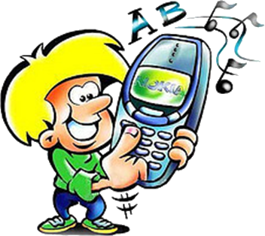
Table of Contents
jQuery Mobile Overview
Methods and Utilities
Responsive Layout
Data-* Attributes
Pages
Dialogs
Buttons
jQuery Events
Features of jQuery Mobile

Slide 3
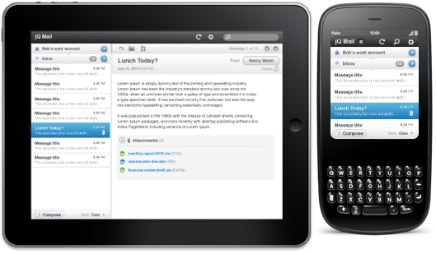
jQuery Mobile Overview
What is jQuery Mobile?

Slide 4
jQuery Mobile Overview
What does jQuery Mobile do?
Top-of-the-line JavaScript in a unified User Interface
Works across the most-used mobile devices
Supports mobile browsers
Treating mobile web browsers exactly the same as desktop web browsers

Slide 5
jQuery Mobile Overview (2)
All pages in jQuery Mobile
Are built on a foundation of clean, semantic HTML
Ensure compatibility with pretty much any web-enabled device
jQuery Mobile applies progressive enhancement techniques
Unobtrusively transform the semantic page into a rich, interactive experience
Leverages the power of jQuery and CSS

Slide 6


Responsive Layout
Media Queries And Stuff...

Slide 7
Responsive Layout
Media Query Helper Classes
jqm adds classes to the HTML element
Mimic browser orientation and common min/max-width CSS media queries
These classes are updated on load, resize and orientationchange
Allowing you to key off these classes in CSS
Create responsive layouts
Even in browsers not supporting media queries!

Slide 8
Orientation Classes
The HTML element will always have a class of either "portrait" or "landscape“
Depending on the orientation of the browser or device
You can utilize these in your CSS like this:
.portrait {
/* portrait orientation changes go here! */
} .landscape {
/* landscape orientation changes go here! */
}

Slide 9
Min/Max Width Breakpoint Classes
By default, min and max breakpoint classes are created at the following widths:
320, 480, 768, 1024
Classes that look like this
"min-width-320px", "max-width-480px"
Can be used as a replacement or addition to the media query equivalents they mimic
.myelement {
float: none;
}
.min-width-480px .myelement {
float: left;
}

Slide 10
Min/Max Width Breakpoint Classes (2)
Plugins in jqm leverage width breakpoints
I.e. form elements float beside their labels when the browser is wider than 480 pixels
The CSS to support this behavior for form text inputs looks like this:
label.ui-input-text {
display: block;
}
.min-width-480px label.ui-input-text {
display: inline-block;
}

Slide 11
Adding Width Breakpoints
jQuery Mobile exposes the function $.mobile.addResolutionBreakpoints
Accepts a single number or array of numbers
Will be added to the min/max breakpoints
Whenever they apply
//add a min/max class for 1200 pixel widths
$.mobile.addResolutionBreakpoints(1200);
//add min/max classes for 1200, and 1440 pixel widths
$.mobile.addResolutionBreakpoints([1200, 1440]);

Slide 12
Running Media Queries
Function allowing testing whether a particular CSS Media Query applies
Just call $.mobile.media() and pass a media type or query
Results in true if that type of query is supported
And currently applies
//test for screen media type
$.mobile.media("screen");
//test a min-width media query
$.mobile.media("screen and (min-width: 480px)");

Slide 13


Responsive Layout
Live Demo

Slide 14
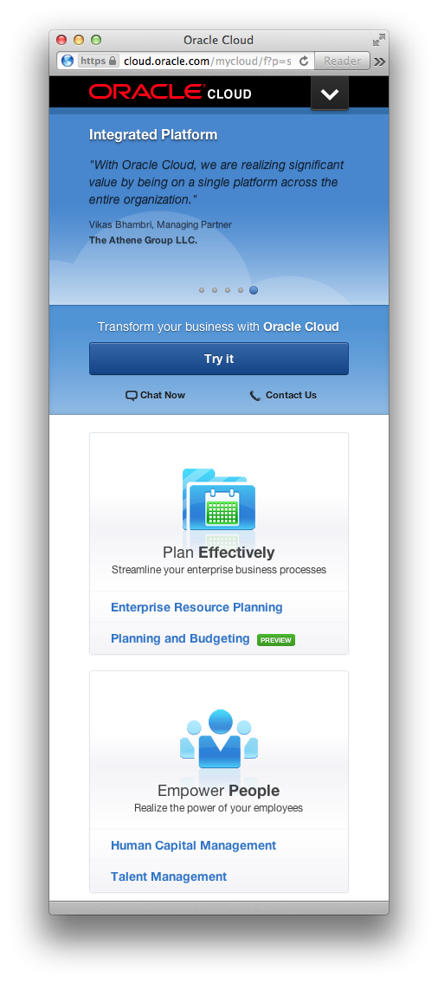

Responsive Web Design

Slide 15


Data-* Attributes
What Is Data-role?

Slide 16
Data-* Attributes
Data-* attributes are used by JavaScript
No pre-defined functionality
Can be different every time
Used to make our own attributes
The following are valid attributes in HTML5
data-role, data-rel, data-pesho, etc.
Data-* attributes are validated in HTML5
jQuery 1.4.1 or later has support for data-*
$("#list").data("role","header");

Slide 17
Data-roles
Data-role is an attribute of HTML element
Used by jQuery UI and jQuery Mobile
Gives appearance to elements
Through jQuery executed in the HTML page init
Data-roles give native look and feel
Based on the OS of the device
Used to make elements look like buttons, pages, menus etc...

Slide 18
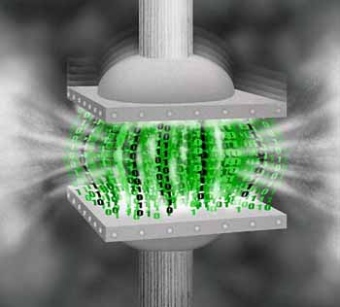

jQuery Mobile Data-*
How to use data-* with jQuery Mobile?

Slide 19


Pages in jQuery Mobile
jQuery Mobile includes automatic AJAX page loading of external pages
With automatic back button history support
A set of animated page transitions
Simple tools for displaying pages as dialogs

Slide 20
Pages
The page structure is optimized to support
Single pages
Local internal linked "pages" within a page
The goal is to allow developers to create websites using best practices
Where ordinary links will "just work"
Without any special configuration
Creating a rich, native-like experience that can't be achieved with standard HTTP requests

Slide 21
Mobile Page Structure
jQuery Mobile sites start with an HTML5 <!doctype html>
Take full advantage of all of the framework's features
Older devices with browsers that don't understand HTML5 will ignore the Doctype
Reference jQuery, jQuery Mobile and the mobile theme CSS in the <head> section

Slide 22
Example jQuery Mobile Site
<!DOCTYPE html>
<html>
<head>
<title>Page Title</title>
<link rel="stylesheet" href="http://code.jquery.com/
mobile/1.0a4.1/jquery.mobile-1.0a4.1.min.css" />
<script type="text/javascript" src="http://code.jquery.
com/jquery-1.5.2.min.js"></script>
<script type="text/javascript" src="http://code.jquery.
com/mobile/1.0a4.1/jquery.mobile-1.0a4.1.min.js">
</script>
</head>
<body>
...
</body>
</html>

Slide 23
Pages in jQuery Mobile
Inside the <body> tag
Every page on a mobile device is identified with an element with data-role="page"
<div data-role="page">
...
</div>
Within a page
Any valid HTML markup can be used
But for true jQuery Mobile Page the immediate children are semantic elements with data-roles
"header", "content", and "footer".

Slide 24
Example of Full Single Page
<!DOCTYPE html>
<html>
<head> <title>Page Title</title> . . .
</head>
<body>
<section data-role="page">
<header data-role="header">
<h1>Some Title</h1>
</header>
<article data-role="content">
<h1>The Content</h1>
</article>
<footer data-role="footer">
<h1>Some Footer</h1>
</footer>
</section>
</body></html>
Page
The Page Header
The Page Content
The Page Footer

Slide 25



Single-Paged jQuery Mobile
Live Demo

Slide 26
Multi-page jQuery Mobile File
With jQuery Mobile one file can contain multiple pages
Many sections with data-role="Page"
Called local pages
Can be accessed from one another by id
<section data-role="page" id="firstPage">…
<article data-role="content">
<a href="#secondPage"> go to second Page</a>
</article>…
</section>
<section data-role="page" id="secondPage">…
<article data-role="content">
<a href="#firstPage"> go to second Page</a>
</article>…
</section>

Slide 27



Multi-page jQuery Mobile
Live Demo

Slide 28
Page Transitions
Six CSS-based transition effects
Applied to any object or page change event
The framework applies the right to left slide transition by default
Add the data-transition attribute to the link
<a href="#secondPage" data-transition="pop">to go second Page</a>
Other possible transitions:
slide, slideup, slidedown, pop, fade, flip

Slide 29
Dialogs
To create dialog window
Add to the anchor a data-rel="dialog"
May add a transition
Get a dialog box
With the page referenced in it
<a href="#dialogPage" data-rel="dialog" data-transition="fade">
Open dialog
</a>

Slide 30


Page and Dialog Transitions
Live Demo

Slide 31
Buttons
With jQuery Mobile elements may be made to look like buttons
Anchor (<a>)
divs and spans (<div>, <span>)
Images (<img>)
All look like the same
<div data-role="button"> div with data-role="button"</div>
<a href="http://www.minkov.it" data-role="button">
anchor with data-role="button"</a>
<img src="images/ClosedBucket.png" width="50" alt="img"
data-role="button"/>

Slide 32
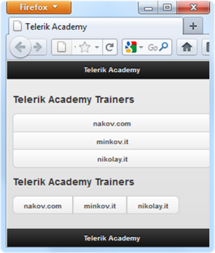
Buttons (2)
Buttons can be grouped in sets of buttons
Both horizontally and vertically
<div data-role="controlgroup" data-type="vertical">
<a href="http://nakov.com" data-role="button">nakov.com</a>
<a href="http://minkov.it" data-role="button">minkov.it</a>
<a href="http://nikolay.it" data-role="button">nikolay.it</a>
</div>
<div data-role="controlgroup" data-type="horizontal">
<a href="http://nakov.com" data-role="button">nakov.com</a>
<a href="http://minkov.it" data-role="button">minkov.it</a>
<a href="http://nikolay.it" data-role="button">nikolay.it</a>
</div>

Slide 33
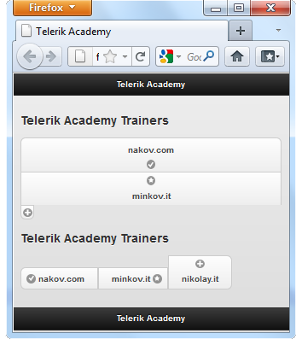
Buttons (3)
Buttons can have
Icons though data-icon
star, check, plus, forward, delete, etc.
Icon position through data-iconpos
bottom | Below the text, centered
left | Left side of button
notext | Hides the text, displaying only the icon
right | Right side of button
top | Above text, centered

Slide 34
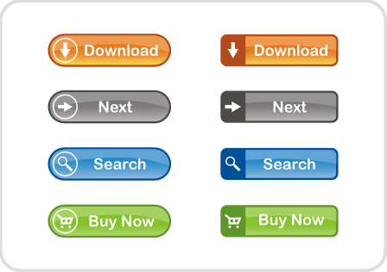
jQuery Mobile Buttons
Live Demo

Slide 35
Listviews
You can make a list (both sorted and not) to look like a menu
Like a menu on a mobile device
Just add data-role="listview"
<ul data-role="listview">
<li>
<a href="#firstPage">go to first Page</a> </li>
<li>
<a href="#secondPage">go to second Page</a> </li>
<li>
<a href="#thirdPage">go to third Page</a> </li>
<li>
<a href="#fourthPage">go to fourth Page</a> </li>
</ul>

Slide 36
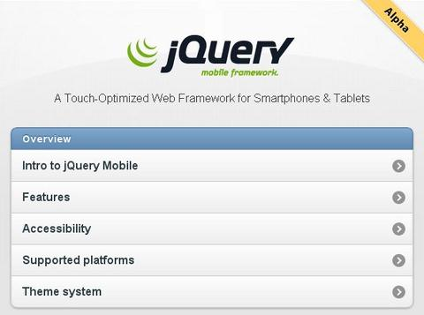
Listviews
Live Demo

Slide 37
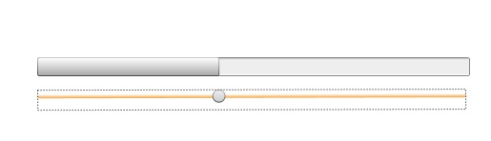
Forms in jQuery Mobile
All the form elements in jQuery Mobile have their own look and feel
Support for features not implemented in browsers yet
i.e. type range

Slide 38
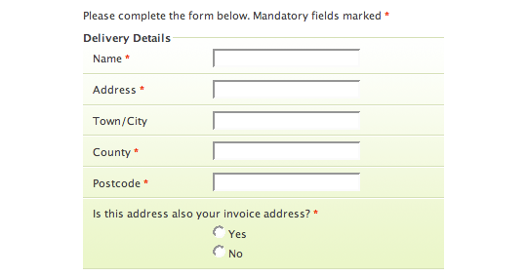
jQuery Mobile Forms
Live Demo

Slide 39
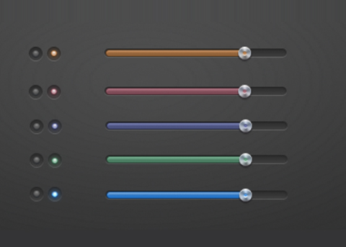
Sliders in jQuery Mobile
Live Demo

Slide 40


HTML5 Form Validation
Live Demo

Slide 41

jQuery Mobile Events
Touch, Orientation, Page

Slide 42
Events in jQuery Mobile
jQuery Mobile offers several custom events
Build upon native events
Create useful hooks for development
Touch, mouse and window events
You can bind to them for use in both handheld and desktop environments
You can bind to these events like you would with other jQuery events
Using live() or bind()

Slide 43
Touch Events
tap
After a quick, complete touch event
taphold
After a held complete touch event
swipe
Horizontal drag of 30px or more, within 1 second
swipeleft
When a swipe event occurred moving in the left
swiperight
When a swipe event occurred moving in the right

Slide 44
Orientation Change Event
orientationchange
Triggers when a device orientation changes
By turning it vertically or horizontally
Leverage a second argument, which contains an orientation property
Equal to either "portrait" or "landscape“
Also added as classes to the HTML element
Allowing you to leverage them in your CSS
Bind to the resize event when orientationchange is not natively supported

Slide 45
Scroll events
scrollstart
Triggers when a scroll begins
Note that iOS devices freeze DOM manipulation during scroll
Queuing them to apply when the scroll finishes
Currently investigating ways to allow DOM manipulations to apply before a scroll starts
scrollstop
Triggers when a scroll finishes

Slide 46
Page show/hide events
When a page is shown/hidden in jQuery Mobile
Two events are triggered on that page
The events triggered depend on whether that page is being shown or hidden
There are actually 4 events
2 for each page

Slide 47
Page show/hide events
pagebeforeshow
Triggered on the page being shown
Before its transition begins
pagebeforehide
Triggered on the page being hidden
Before its transition begins
pageshow
Triggered on the page being shown
After its transition completes
pagehide
Triggered on the page being hidden
After its transition completes

Slide 48
Page show/hide events
Note that all four of these events expose a reference to either
The next page (nextPage)
The Previous page (prevPage)
Depending on whether the page is being shown or hidden
Whether that next or previous page exists

Slide 49
Page show/hide events
You can access the reference of the page via the second argument of a bound callback
To invoke these handlers during initial page load
Bind them before jQuery Mobile executes
Can be done in the mobileinit handler
$('div').live('pageshow',
function(event, ui){
alert('This page was just hidden: '+ ui.prevPage);
});
$('div').live('pagehide',
function(event, ui){
alert('This page was just shown: '+ ui.nextPage);
});

Slide 50
Page Show/Hide Events
Live Demo

Slide 51
Page initialization events
jQuery Mobile auto-initializes plugins
Based on markup conventions found in a page
I.e. an input element with a type of range will automatically generate a custom slider control
Auto-initialization is controlled by page plugin
Dispatches events before and after it executes
Allows manipulation of a page
Either pre-or-post initialization
Provide your own initialization behavior and prevent the auto-initializations from occurring

Slide 52


Page initialization events
Page initialization events will only fire once per "page"
Opposed to the show/hide events
Fire every time a page is shown and hidden

Slide 53
Page initialization events
pagebeforecreate
On page initialized, before initialization occurs
$('#aboutPage').live('pagebeforecreate',
function(event){
alert('This page was just inserted into the dom!');
});
pagecreate
On page initialized, after initialization occurs
$('#aboutPage').live('pagecreate',function(event){
alert('This page was just enhanced by jQuery Mobile!');
});

Slide 54
Page initialization events
When binding to pagebeforecreate and returning false
You can prevent the page plugin from making its manipulations
$('#aboutPage').live('pagebeforecreate',
function(event){
//run your own enhancement scripting here...
return false;
});

Slide 55

jQuery Mobile Init Events
Live Demo

Slide 56

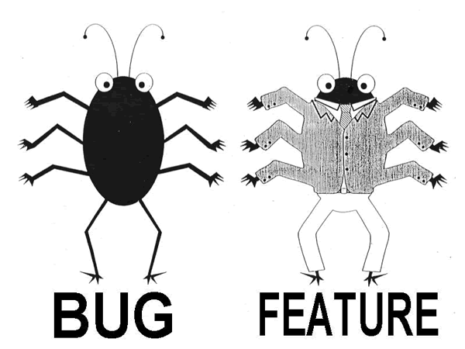
Features of jQuery Mobile
What to Expect?

Slide 57
Features of jQuery Mobile
Built on jQuery core for familiar and consistent jQuery syntax
Compatible with all major mobile platforms
iOS, Android, Blackberry, Palm WebOS, bada, Nokia/Symbian, Windows Mobile, WP7 Mango
Support for devices understanding HTML
Lightweight size
12k compressed for all mobile functionality
Minimal image dependencies for speed

Slide 58
Features of jQuery Mobile
HTML5 Markup-driven configuration for fast development and minimal required scripting
Pages and behavior
Progressive enhancement approach brings
Core content and functionality to all mobile, tablet and desktop platforms
A rich, installed application-like experience on newer mobile platforms

Slide 59
Features of jQuery Mobile
Automatic initialization by data-* attributes in the HTML markup
Trigger initialization of jQuery Mobile widgets
New events for support of touch, mouse, and cursor focus-based user input
New plugins enhance native controls with touch-optimized, themable controls

Slide 60



Supported Platforms
These browsers have a solid jqm experience
Apple iOS (3.1-4.2)
Android (1.6-2.3) all devices
Blackberry 6
Windows Phone 7 Mango
Palm WebOS (1.4)
Opera Mobile (10.1)
Opera Mini (5.02)
Firefox Mobile (beta)

Slide 61



jQuery Mobile

Slide 62
Homework
Create multiple pages with different content
Using HTML5 and jQuery Mobile
Link the pages from the above exercise
Create a form with validation
Try to copy one of the famous mobile apps
For example "Phone book" for Android
Expend the previous with adding more options
Screens for adding and editing new contacts
Screen for view of a contact
Etc.

